Slide 1

ITCS 4152/5152: Speed Limit Sign Detection
Group 11: Thomas Carr, Kyle Ward, Payne Miller, Jay Yadav, Makalia Vang

Slide 2

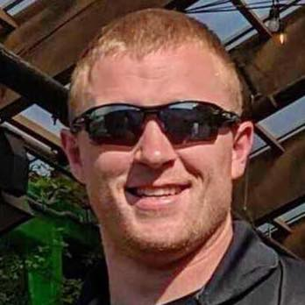
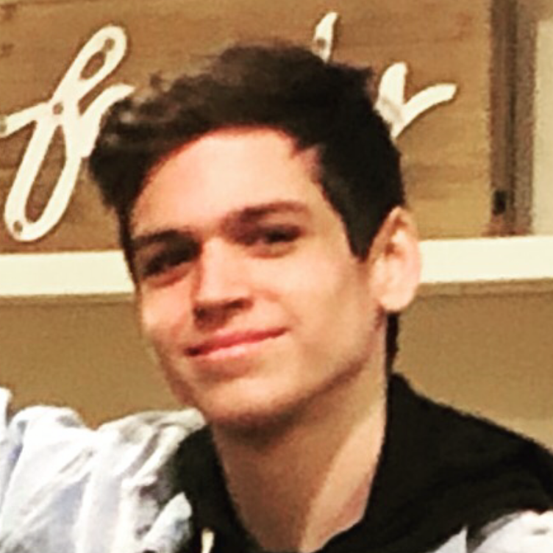
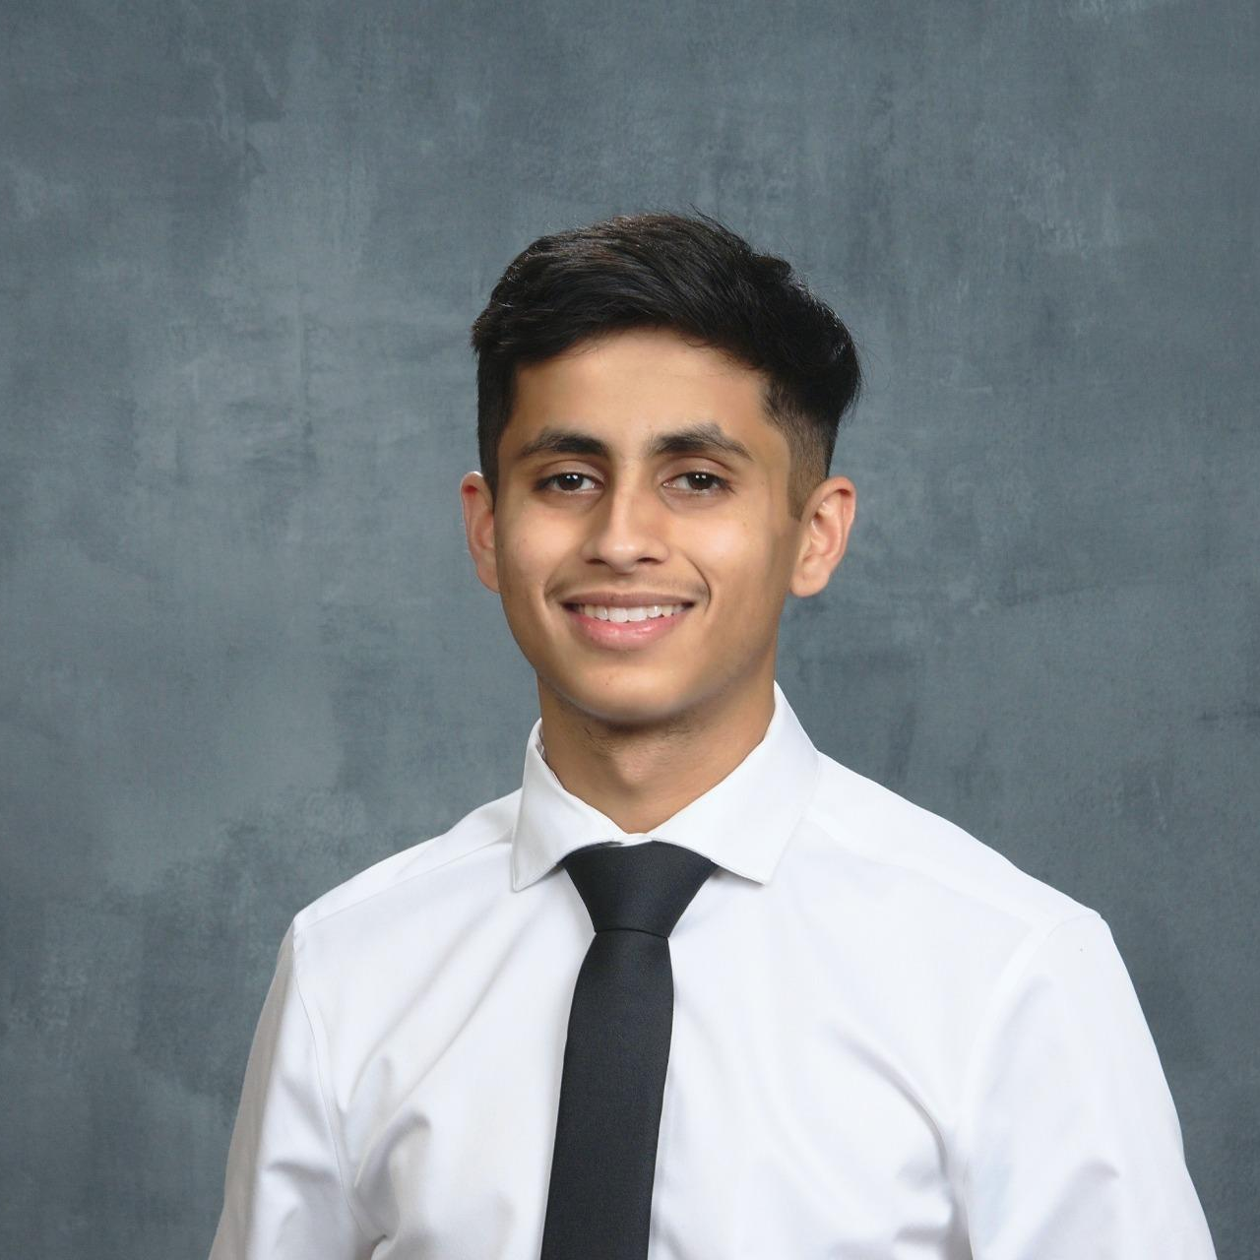
Introductions
Payne Miller
Preparation of Data & Research
Assisted with Backend Demo
Presentation Creation
Kyle Ward
Model Creation & Research
Presentation Creation
Jay Yadav
Preparation of Data & Research
Assisted with Backend & Frontend Demo
Presentation Creation

Slide 3

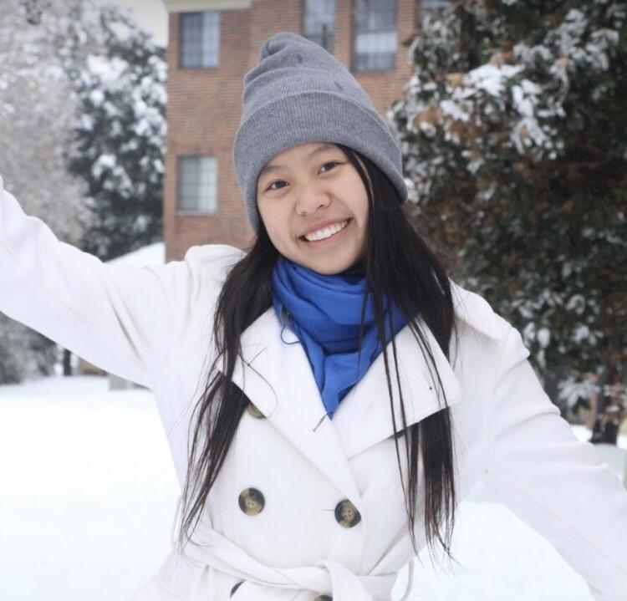
Introductions
Thomas Carr
Preparation of Data & Research
Assisted with Backend & Frontend Demo
Model Creation & Research
Makaila Vang
Presentation Creation
Preparation of Data & Research

Slide 4
Problem and Motivation
Speed Limit Detection
Sometimes the speed limit can switch suddenly and traditional GPS systems don’t always have the right information stored (outdated.)
Speeding Tickets are expensive.
There are two main customers for our project:
Autonomous vehicles
Need to know what speed it is allowed to do without relying on external data.
Map/GPS companies.
Can use Street View images in order to get the speed limit of roads.
Notes:
Payne

Slide 5
Our Dataset
We used 1,000 images of various quality, lighting, and speed limit values within our model.
Obtained images via the Open Source platform Kaggle.
Labels follow the format: speedLimit{Value}_{id}.avi_image{imageNumber}.png
Train/Test/Validation Split:
Train (70%): 767 images
Test (10%): 106 images
Validation(20%): 216 images
Notes:
Payne

Slide 6
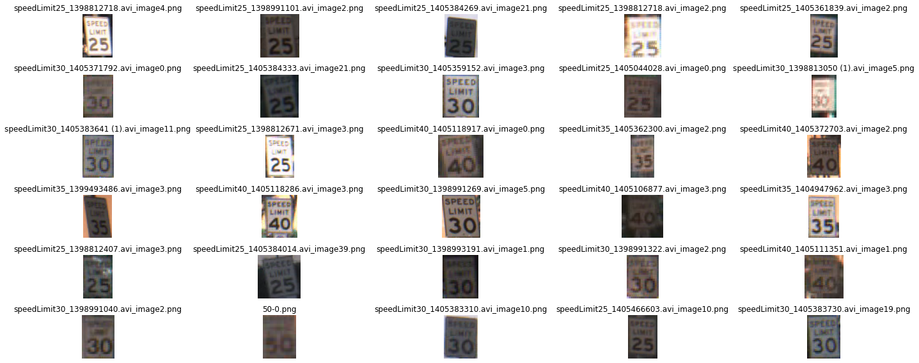
Our Dataset (cont.)
Notes:
Payne

Slide 7
Our Methodology
Our model is a CNN built using Tensorflow 2
Utilizes max pooling, average pooling, and upsampling layers for feature extraction
Adam optimizer with Categorical Cross-entropy loss function
Output is a probability distribution of possible classes (25,30,35,40,45,50mph)
Outside-In approach:
Assumptions: Speed limit sign is square, numbers will always be contained within this square. Number will exist solely of lines and curves
First Conv-Pooling layer uses a max-pool pair for extracting the parts that define the lines of the rectangle and parts of the numbers
Second Conv-Pooling layer pair uses an average-pool to extract the contours and curvatures of the numbers
These are upsampled before feeding into the MLP part of the network
We transformed the images into 64 x 64 pixels and applied a Grayscale filter.
Notes:
Kyle and Thomas

Slide 8
Our Methodology - Second Model
3 Convolutions Before Any Pooling
In hopes of finding a new parameters missed by a simpler model
Reshaped Images to 224x224x3
Used RGB instead of BW
Added More Data Augmentation
Gaussian Blur
Rotation (30°)
X/Y Shifting (30px)
Regularization
Batch Normalization
Dropout
80/20 train/test split
_________________________________________________________________
Layer (type) Output Shape Param #
=================================================================
conv2d_44 (Conv2D) (None, 224, 224, 16) 784
conv2d_45 (Conv2D) (None, 224, 224, 16) 4112
conv2d_46 (Conv2D) (None, 224, 224, 16) 4112
batch_normalization_18 (None, 224, 224, 16) 64
average_pooling2d_8 (None, 112, 112, 16) 0
conv2d_47 (Conv2D) (None, 112, 112, 32) 4640
conv2d_48 (Conv2D) (None, 112, 112, 32) 9248
conv2d_49 (Conv2D) (None, 112, 112, 32) 9248
batch_normalization_19 (None, 112, 112, 32) 128
average_pooling2d_9 (None, 56, 56, 32) 0
conv2d_50 (Conv2D) (None, 56, 56, 64) 18496
conv2d_51 (Conv2D) (None, 56, 56, 64) 36928
conv2d_52 (Conv2D) (None, 56, 56, 64) 36928
batch_normalization_20 (None, 56, 56, 64) 256
max_pooling2d_12 (None, 28, 28, 64) 0
conv2d_53 (Conv2D) (None, 28, 28, 128) 73856
conv2d_54 (Conv2D) (None, 28, 28, 128) 147584
conv2d_55 (Conv2D) (None, 28, 28, 128) 147584
batch_normalization_21 (None, 28, 28, 128) 512
max_pooling2d_13 (None, 14, 14, 128) 0
flatten_5 (Flatten) (None, 25088) 0
dense_25 (Dense) (None, 256) 6422784
dropout_17 (Dropout) (None, 256) 0
dense_26 (Dense) (None, 128) 32896
dropout_18 (Dropout) (None, 128) 0
dense_27 (Dense) (None, 32) 4128
dropout_19 (Dropout) (None, 32) 0
dense_28 (Dense) (None, 16) 528
dense_29 (Dense) (None, 7) 119
=================================================================
Total params: 6,954,935
Trainable params: 6,954,455
Non-trainable params: 480
_________________________________________________________________
Notes:
Kyle and Thomas

Slide 9
Results
Our best model achieved 90% accuracy.
From a development perspective:
Started with a base model of 85% accuracy
From there we iterated to 86% accuracy
Ultimately optimized up to 90% accuracy.
We used the simple formula for Accuracy:
Accuracy = number of correct reads / total number of reads.
Accuracy was categorical cross entropy.
Notes:
Kyle and Thomas

Slide 10
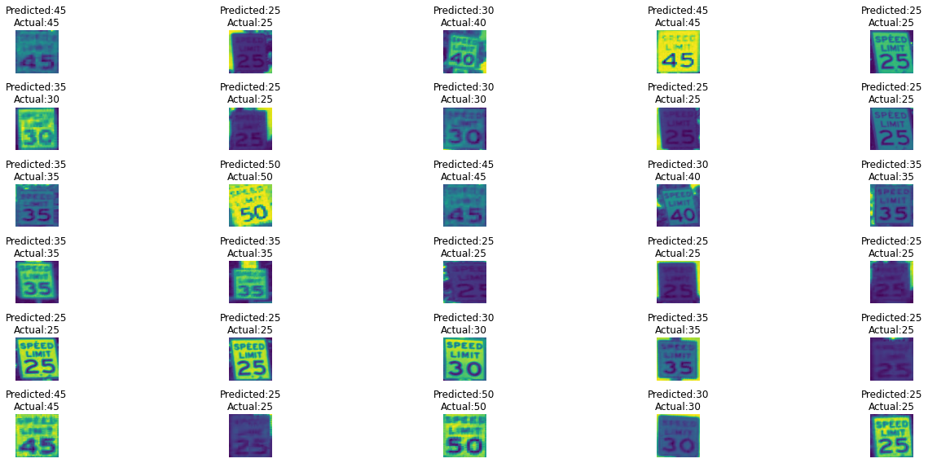
Results (cont.)
Notes:
Kyle and Thomas

Slide 11
Conclusions
Our best model achieved 90% accuracy.
Faced some challenges
Scheduling between full-time students and full-time employees/part-time students.
We were pre-processing the images on our own, but then figured out a CNN would do it better.
Picking a topic of interest
Finding a large, diverse, dataset was a huge boon.
Notes:
Jay

Slide 12
Live Demo
Hosted our backend server on a personal server machine.
Wanted to hit a stretch goal of a live system demonstration.
speadle.web.app
Notes:
Jay

Slide 13
Q & A
Any questions?

Slide 14
Thank you!
Thank you Professor Archit and TAs.

